Slide 1
Some Slides Are HIDDEN
Please Note: Some slides in this file are hidden from view on the Cable Access Chanel, and due to their frequent use are left in the file and updated periodically so that when they are needed they are un-hidden for a time. Hidden slides will have a slash through their slide number and can still be viewed by downloading the file and opening it in PowerPoint.

Slide 2

Check Out Our Website ! !
www.CamdenCountyNC.gov

Slide 3
Public Wifi at
COA-Currituck & COA-Elizabeth City
COA now has FREE Wifi for students and the community in Currituck and Elizabeth City.
The new “Park and Surf” lots are located in front of the campus building in Currituck and in front of the John Wood Foreman Technology Center (FC Building) in Elizabeth City.
Choose “COA-Public” in your Wifi settings.

Slide 4
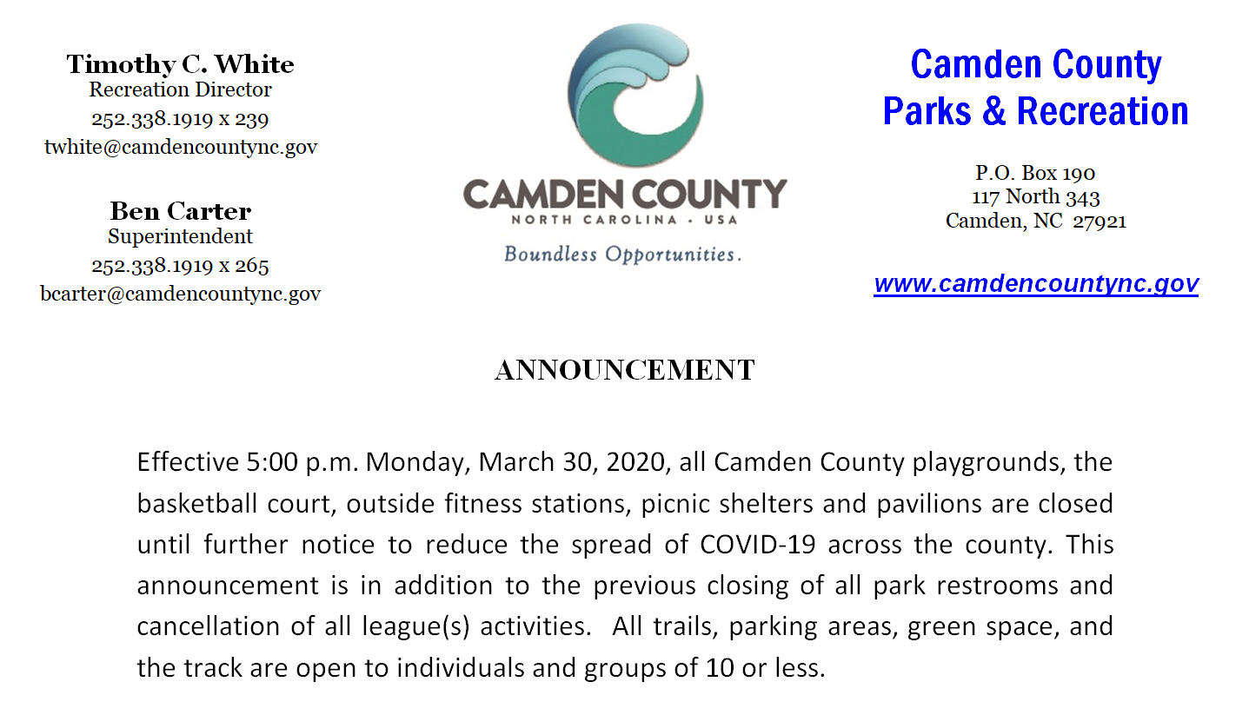

Slide 5


CAMDEN
COUNTY
PUBLIC
LIBRARY
OPEN TO PUBLIC
Camden County Library is OPEN to the Public.
Hours are 9AM - 5PM, M-F. Sorry No Weekends.
Closed from 1PM-2PM Each Day for Cleaning.
Digital Content is available online.
For more information, call 252-331-2543.
The library is located at 104 Investors Way on East Hwy 158, behind
and to the right of the Camden County Manager’s Office.

Slide 6
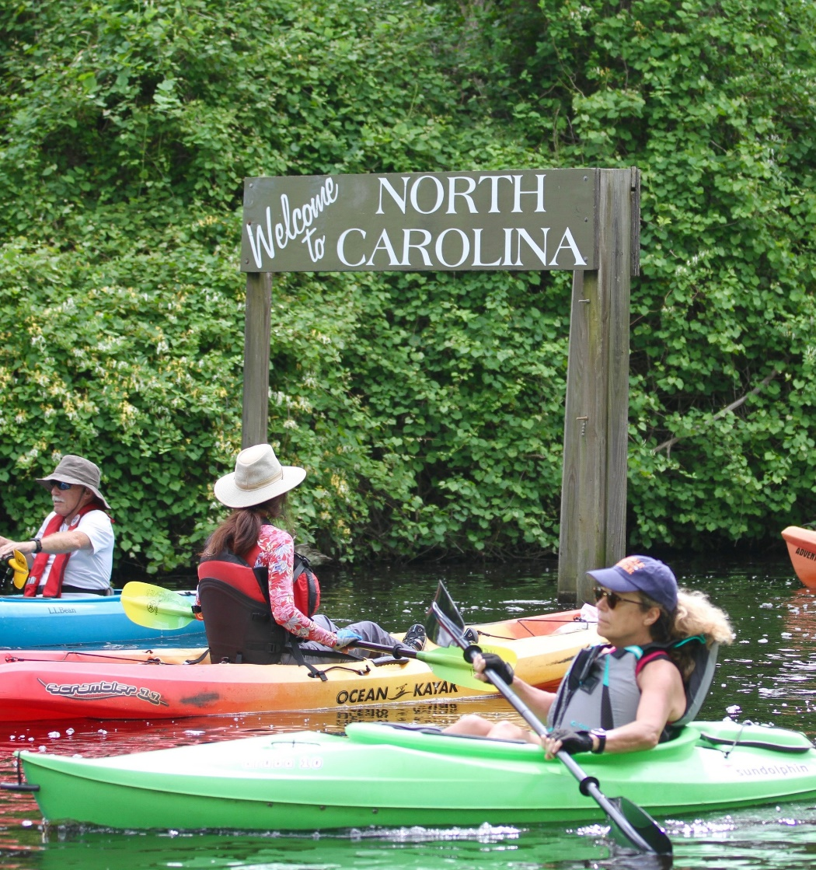


17th Annual Paddle for the Border
Saturday, May 7th , 2022
Paddle 7.5 miles from South Mills, NC
to Chesapeake, VA
Registration fills early and
limited to 375 paddlers!
For more information contact:
Dismal Swamp State Park
(252) 771-6593
Camden Tourism Development Authority
(252) 771-8333
dscwelcome@camdencountync.gov

Slide 7


Slide 8


Slide 9


Slide 10


Slide 11

CAMDEN FOOD PANTRY
Located at
Camden United Methodist Church
197 NC hwy 343 South Camden, NC
DRIVE THRU SERVICE ONLY
9:30am to11:00am
252-335-7565
Sept 7 & 21
Oct 5 & 19
Nov 2 & 16
Dec 7 & 14

Slide 12

FRA Branch 293 Seeks Entries in
Americanism Essay Contest
Members of FRA (Fleet Reserve Association) Branch 293 invite all students in grades 7 through 12 to participate in the Association’s 2021-2022 Americanism Essay Contest. Participants are invited to submit a 350-word essay centered on this year’s theme: “Why I am Proud to be an American”.
This national contest, sponsored by FRA to promote a spirit of patriotism among America’s youth, offers a Grand National Prize of $5,000, with other recognition in each grade category.
Each entrant must be sponsored by an FRA member or branch. We’re proud to sponsor students, including those who are home-schooled.
Winners are selected at the Branch level in each grade category, which are forwarded to compete in one of FRA’s eight regions. Regional winners are then forwarded to the Association’s National Americanism Committee, where first, second and third-place winners are selected in each grade category. The Grand National Winner is selected from this elite group of writers and receives a $5,000 cash award.
Essays must be legibly written or typed on one side of the paper and each entry must include a Cover Letter found at Branch Facebook Page. Essays must be submitted through an FRA member or local FRA branch before the December 1st deadline.
Contest Rules can be found on our Facebook Page
To learn more about FRA’s Americanism Essay Contest,
Contact TC Wright at AmericanismEssays@gmail.com.
Mail to:
FLEET RESERVE ASSOCIATION
Branch 293
P.O. Box 1753
Elizabeth City, North Carolina 27906-1753
Visit our Facebook Page:
https://www.facebook.com/FRA-Branch-293-1931865113800448/

Slide 13
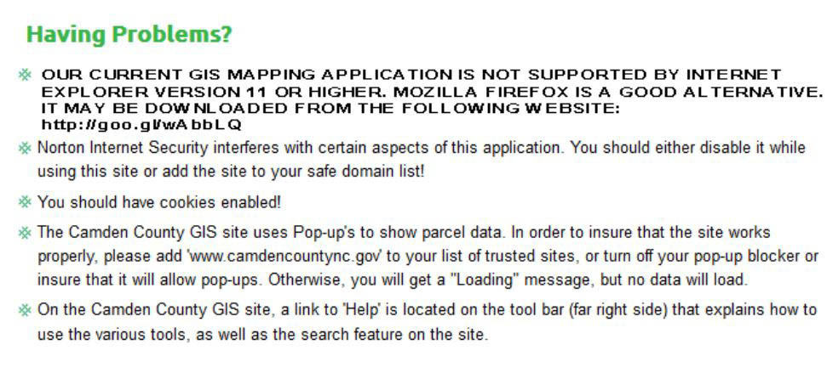
Trying to Access our GIS?
This may be some help to you:

Slide 14
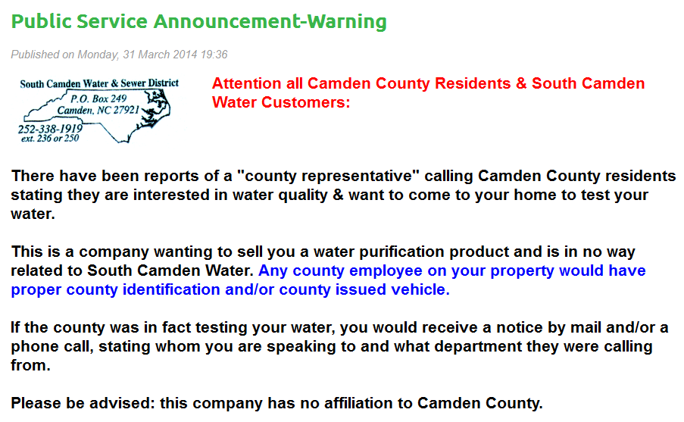

Slide 15
Camden County
Board of Social Services
The Camden County Board of Social Services holds its regular meeting on the 2nd Tuesday of each month, except as noted below, at 5:00 PM at the Camden County Library.
Exceptions: None at this time.

Slide 16
Camden County
Tourism Development Authority
The Camden County Tourism Development Authority will meet quarterly on the second Tuesday of the first month in each quarter (Jan., April, July, Oct.) upstairs in the Historic Courthouse at 9:30am. For more information call Sarah Hill, Dismal Swamp Welcome Center, at 252-771-8333.

Slide 17
Camden County
Parks & Recreation Advisory Board
The Camden County Parks & Recreation Advisory Board meets in the Camden County Sheriff’s conference room at 6:00 PM Every Other Month.
For more information contact Tim White, Camden Parks & Rec Director, at 252-338-1919 x 239

Slide 18

Scouting Volunteers Needed
The Tidewater Council, Albemarle District of the Boy Scouts of America is seeking volunteers for many positions within the Boy Scouts…
Seeking any former Eagle Scouts, Scouters, or any adults looking to give some time to aid the youth of the Albemarle District…
If you are interested in volunteering, contact Mr. Jeffrey Kissell @ 757-409-3281 or email: jkissell@bsamail.org

Slide 21


Slide 22
CAMDEN
COUNTY
PUBLIC
LIBRARY
Hours of Operation
Monday - Tuesday: 9:00 AM to 7:00 PM
Wednesday – Friday: 9:00 AM to 6:00 PM
Saturday: 10:00 PM to 4:00 PM
Closed on Sundays & County Holidays
For more information, call 252-331-2543.
The library is located at 104 Investors Way on East Hwy 158, behind
and to the right of the Camden County Manager’s Office.

Slide 23
CAMDEN
COUNTY
PUBLIC
LIBRARY
Available Services
Send / Receive Fax (for fee)
Copy Machine (for fee)
Public Use Computers
**FREE Wi-Fi**
For more information, call 252-331-2543.
The library is located at 104 Investors Way on East Hwy 158, behind
and to the right of the Camden County Manager’s Office.

Slide 24
CAMDEN
COUNTY
PUBLIC
LIBRARY
Fee Schedule
Copies:
  8-½”x11”, 8-½”x14” (B/W)....$0.10/page
  8-½”x11”, 8-½”x14” (Color)...$0.25/page
  11”x17” (B/W).......................$0.20/page
  11”x17” (Color)......................$0.50/page
Incoming Fax..............................$0.10/page
Inter Library Loan.......................$3.50

Slide 25
CAMDEN
COUNTY
PUBLIC
LIBRARY
Returning / Renewing
You can now return or renew library materials checked out from the Currituck, Dare, or Pasquotank Libraries conveniently right here in Camden !
For more information, call 252-331-2543.
The library is located at 104 Investors Way on East Hwy 158, behind
and to the right of the Camden County Manager’s Office.

Slide 26
CAMDEN
COUNTY
PUBLIC
LIBRARY
Public Use Computers
We Provide computer help for:
Basic Skills
Research
Tablets
Job Networking
Microsoft Office
& More
For more information, call 252-331-2543.
The library is located at 104 Investors Way on East Hwy 158, behind
and to the right of the Camden County Manager’s Office.

Slide 27
CAMDEN
COUNTY
PUBLIC
LIBRARY
Friends of the Library
Come Join Us !
2nd Monday of Each Month, 3:00 - 5:00 PM
(except on Holidays)
For more information, call 252-331-2543, or email us at friendsofthecamdenlibrary@gmail.com
The library is located at 104 Investors Way on East Hwy 158, behind
and to the right of the Camden County Manager’s Office.

Slide 28
CAMDEN
COUNTY
PUBLIC
LIBRARY
Big Kid Story Time
For Children Ages 4-8 Years
Every Thursday at 3:30 PM
For more information, call 252-331-2543.
The library is located at 104 Investors Way on East Hwy 158, behind
and to the right of the Camden County Manager’s Office.

Slide 29
CAMDEN
COUNTY
PUBLIC
LIBRARY
Toddler Story Time
For Children Ages 2-4 Years
Every Wednesday at 10:00 AM
For more information, call 252-331-2543.
The library is located at 104 Investors Way on East Hwy 158, behind
and to the right of the Camden County Manager’s Office.

Slide 30
CAMDEN
COUNTY
PUBLIC
LIBRARY
Baby Story Time
For Children Ages Birth - 2 Years
Every Thursday at 10:30 AM
For more information, call 252-331-2543.
The library is located at 104 Investors Way on East Hwy 158, behind
and to the right of the Camden County Manager’s Office.

Slide 31
CAMDEN
COUNTY
PUBLIC
LIBRARY
Programming for Ages 9-Up
Makerspace, Breakout EDU, LEGO Club, & More
Times & Dates Vary, Check Facebook or
Website for more details.
For more information, call 252-331-2543.
The library is located at 104 Investors Way on East Hwy 158, behind
and to the right of the Camden County Manager’s Office.

Slide 32
CAMDEN
COUNTY
PUBLIC
LIBRARY
Baby Book Club
For Children Ages Birth-2 Years
Every Thursday at 10:30 AM
For more information, call 252-331-2543.
The library is located at 104 Investors Way on East Hwy 158, behind
and to the right of the Camden County Manager’s Office.

Slide 33
CAMDEN
COUNTY
PUBLIC
LIBRARY
Adult Book Club
Book: Check Website or Facebook for book assigned
Meets 3rd Monday Each Month (except December)
For more information, call 252-331-2543.
The library is located at 104 Investors Way on East Hwy 158, behind
and to the right of the Camden County Manager’s Office.

Slide 34
CAMDEN
COUNTY
PUBLIC
LIBRARY
Library Board of Trustees Mtg
Public is invited to attend
Meeting is March 21, 2017 at 5:15 PM
For more information, call 252-331-2543.
The library is located at 104 Investors Way on East Hwy 158, behind
and to the right of the Camden County Manager’s Office.

Slide 35

Do you or someone you know need help paying for Medicare coverage?
Medicare recipients with limited income and assets may qualify for money-saving programs, called Extra Help and Medicare Savings Program.
These programs may save you money on the following:
Extra Help
Medicare Prescription Drug Plan premiums
Medicare prescription drug deductibles and copayments.
Medicare Savings Program
Medicare medical coverage deductibles and copayments
Medicare medical coverage premiums.
If so, the
Extra Help program may be able to help!
For more information OR
for help completing an application, contact:
NC SHIIP
855-408-1212
Albemarle Commission
Area Agency on Aging
252-426-5753 ext. 232
There are more than 60 Medicare beneficiaries in Camden County who may be eligible for help but have yet to apply. Applications are easy to complete and we are happy to assist you!

Slide 36
Public Wifi at
COA-Currituck & COA-Elizabeth City
COA now has FREE Wifi for students and the community in Currituck and Elizabeth City.
The new “Park and Surf” lots are located in front of the campus building in Currituck and in front of the John Wood Foreman Technology Center (FC Building) in Elizabeth City.
Choose “COA-Public” in your Wifi settings.

Slide 38
CAMDEN
COUNTY
PUBLIC
LIBRARY
OPEN TO PUBLIC
Camden County Library is OPEN to the Public.
Hours are 9AM - 5PM, M-F. Sorry No Weekends.
Closed from 1PM-2PM Each Day for Cleaning.
Digital Content is available online.
For more information, call 252-331-2543.
The library is located at 104 Investors Way on East Hwy 158, behind
and to the right of the Camden County Manager’s Office.

Slide 39


No job? No skills? No money?
WIA YOUTH AND ADULT PROGRAMS
NOW ACCEPTING APPLICATIONS
We may be able to help you identify realistic options, real opportunities, and a real plan to move forward with your life.
For more information visit: www.NWDBworks.org or call 252-426-5753 ext. 261

Slide 40
WIA YOUTH PROGRAM
EVER WONDER:
HOW WE CAN HELP:
Why do I need my High School Diploma?
Do I really need to go to college?
How can I get a job?
How can I make enough money to do what I want with my life?
We will help you to identify realistic options, real opportunities, and a plan to move forward with your life through:
Paid and Unpaid Work Experience
Career Counseling
Leadership Development Opportunities
Mentoring
Childcare & Transportation Assistance
Alternative Secondary School Offerings
Tutoring
Occupational Skills Training
For more information visit: www.NWDBworks.org or call 252-426-5753 ext. 261

Slide 41
WIA ADULT PROGRAM
EVER WONDER:
HOW WE CAN HELP:
I got laid off from my job. What now?
I can’t find a job in my field. How can I transition into a new career?
How can I get trained for a new career?
How can I get a better job to support my family?
Career Counseling
Job Search Assistance
Resume & Interview Preparation
On-the-Job Training Opportunities
Training Scholarships
Childcare/Transportation Assistance
For more information visit: www.NWDBworks.org or call 252-426-5753 ext. 261

Slide 42
WHO IS ELIGIBLE?
YOUTH REQUIREMENTS
ADULT REQUIREMENTS
Low Income
And:
  Pregnant/Parenting
  Offender
  Homeless/Runaway
  Foster Care/Former Foster
  Basic Skills Deficient
  High School Dropout
Low Income or
Dislocated Worker
(laid off from your previous job through no fault of your own)
And Unable to Obtain Employment with Current Job Skills
For more information visit: www.NWDBworks.org or call 252-426-5753 ext. 261

Slide 43
NWDB Business Services
Providing Solutions to Enhance and Strengthen Businesses
Training Opportunities & Grants for:
  New & Current Employees
  Business Owners and Managers
Recruiting & Screening for Qualified Applicants
Identifying Occupations-Specific Labor & Compensation Statistics
Preparing Job Descriptions & Interview Materials
Facilitating Connections to Other Business Services Agencies
For more information visit: www.NWDBworks.org or call 252-426-5753 ext. 261

Slide 44

State Energy Sector Partnership Grant
Grow our Green Economy
  Energy – Efficiency & Renewables
  Training for Businesses & Individuals
For more information visit: www.NWDBworks.org or call 252-426-5753 ext. 261

Slide 45

WIA YOUTH AND ADULT PROGRAMS
NOW ACCEPTING APPLICATIONS
www.NWDBworks.org
or call 252-426-5753 ext. 261
This is a FREE federal program to qualified applicants

Slide 46
Free Weatherization of Homes
I saved over $1200
on my energy bills last year ! !
Find Out How Weatherization
Can Help You Save Too ! !
For more information,
call (252) 338-7720

Slide 47

Low Income Energy Assistance Program
For More Details Contact
Camden County Dept of Social Services
331-4787

Slide 48
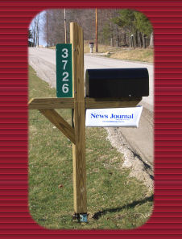
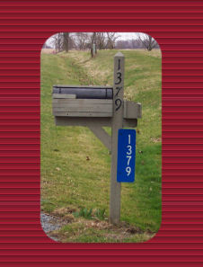
        Get your REFLECTIVE ADDRESS MARKER from the South Camden Fire Dept., Sawyer’s Creek Road, Camden
        FEATURES: $14.00
        • Highly Visible Day or Night
        • Reflective Material on Both Sides
        • Fade Resistant, Last for Years
        • Pre-drilled Holes

Slide 49
Seeking Volunteers
Camden County is seeking qualified, knowledgeable and dedicated citizens.
Anyone interested in serving on any Boards or Commissions, please go to www.camdencountync.gov and fill out a volunteer form or stop by the Clerk to the Board’s office for a form.
For more info call 252.338.6363.

Slide 50
Seeking Volunteers
Camden County is currently seeking volunteers for the following boards:
•Planning Board

Slide 51


Pasquotank-Camden Special Needs Registry
Do you have a special need that may cause you to require assistance during an emergency or disaster?
If so, you need to register for the Pasquotank-Camden Special Needs Registry!
The registry is voluntary and
strictly confidential.

Slide 52
Pasquotank-Camden Special Needs Registry
Emergency personnel use the registry to check on you and / or assist you in relocation in emergency situations.
You should register if you may require special assistance due to the following conditions:
Cardiac History
Respiratory Problems
Hearing, Speech,
Vision Impairment
Mobility Issues
History of Stroke
Frail elderly
Mentally Challenged
Any other severe medical or
disabling condition

Slide 53

To register for the Pasquotank-Camden Special Needs Registry:
Call the Pasquotank-Camden
Emergency Management Agency at
252-335-4444 OR 252-335-2307 TTY
OR
Register online at www.co.pasquotank.nc.us

Slide 54
OPEN HEARTS
AFTER SCHOOL PROGRAM
TRINITY UNITED METHODIST CHURCH
104 MAIN STREET, SOUTH MILLS
IS ACCEPTING APPLICATIONS FOR AFTER SCHOOL CARE - K – 5TH GRADE.
CALL 252-771-5069 (3 PM – 6 PM)

Slide 55
CONVENIENCE SITE HOURS:
CAMDEN TOWNSHIP
Located on Chantilly Road, Camden
Open Mon, Tues, Wed, Fri, Sat 7:00 am - 7:00 pm
Thursday 7:00 am-2:00 pm; Sunday 1:00 pm-6:00 pm
SHILOH TOWNSHIP
Located on Wickham Road, Shiloh
Open Monday, Wednesday,
Friday and Saturday 7:00 am - 7:00 pm
Open Sunday 1:00 pm - 6:00 pm
Closed Tuesday and Thursday
SOUTH MILLS TOWNSHIP
Located on North NC 343, South Mills
Open Monday, Wednesday,
Friday and Saturday 7:00 am - 7:00 pm
Open Sunday 1:00 pm - 6:00 pm
Closed Tuesday and Thursday

Slide 56
RECYCLE !!!
RECYCLE !!!
RECYCLE!!!
New Co-Mingling Compactor on Site at the
South Mills Convenience Site

Slide 57
NATIONAL SAFE KIDS CAMPAIGN
Pasquotank/Camden EMS is dedicated to your child’s safety. Programs through SAFE KIDS include Child Passenger Safety, Water Safety & Bike Safety. EMS also provides youth education on EMS thru hands-on demonstrations of EMS equipment & apparatus. EMS works closely with area fire & law enforcement to enhance the learning process. For info on programs call 252-225-1524.

Slide 58
Go to www.fda.gov for information regarding RECALLED FOOD and PET products, and food safety.
U. S. Food and Drug Administration
5600 Fishers Lane, Rockville MD 20857-0001
1-888-INFO-FDA (1-888-463-6332)

Slide 59
Call Before You Dig!!
To Locate Water Lines, Cable Lines, Electrical Lines and Phone Lines
Call 1-800-632-4949
48 Hours before you want to dig.
Protect yourself and Others!

Slide 60

CAMDEN COUNTY SHERIFF’S OFFICE
EMERGENCIES - DIAL 911
TO REPORT CRIMES - 252-331-7445
CRIMELINE - 252-335-5555
(YOU DO NOT HAVE TO GIVE YOUR NAME - REWARD FOR INFO THAT LEADS TO ARREST)
ALL OTHER BUSINESS - 252-338-5046

Slide 61
You don’t have to put up with pushy door-to-door salespeople…
If you are bothered by pushy sales tactics, call the Sheriff’s Office and report it…
We want you to know that you can call the Sheriff’s Office if any pushy salesperson bothers you. 252-338-5046.

Slide 62
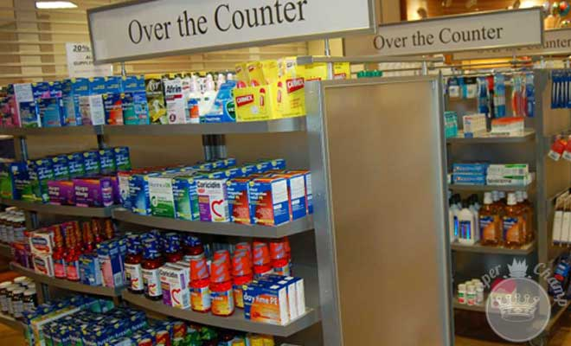
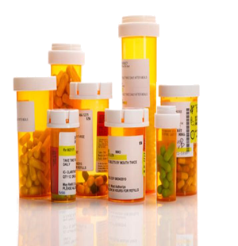
Do you Know What Is in your Medicine Cabinet?
Do you have unused or expired prescription/over the counter medicine in your medicine cabinet at home and you are not sure how to dispose of it? Camden Sheriff’s Office is a registered drop off location with the North Carolina Department of Insurance. Drop off your unused or expired prescription at the Sheriff’s Office at 117 North NC 343 (Courthouse). Monday - Friday 8 am - 5pm.

Slide 63

IF YOU HAVE RECEIVED A NOTICE FROM THE IRS STATING YOU HAVE UN-REPORTED INCOME FROM A COMPANY YOU HAVE NEVER WORKED FOR…
You could be a victim of IDENTITY THEFT!
If this happens to you, please notify the Sheriff’s Office and the Camden County Tax Department
Documentation you will need to have in order to resolve this issue:
File a Police Report
Report ID Theft to Credit Bureaus
File Incident with Federal Trade Commission
Provide IRS with Supporting Documentation
For More Information, Contact:
Camden County Tax Department
252-338-1919 ext 266

Slide 64
VOLUNTEERS NEEDED FOR THE SOUTH MILLS AND SOUTH CAMDEN FIRE DEPARTMENTS
The two Fire Departments of Camden County need people to join the Fire Departments to save homes, lives and businesses from the threat of fires.
As the county grows, so must our Fire Departments. Let us remember that we all may need help at sometime.
Camden FD

Slide 65
Public Wifi at
COA-Currituck & COA-Elizabeth City
COA now has FREE Wifi for students and the community in Currituck and Elizabeth City.
The new “Park and Surf” lots are located in front of the campus building in Currituck and in front of the John Wood Foreman Technology Center (FC Building) in Elizabeth City.
Choose “COA-Public” in your Wifi settings.

Slide 67

PUBLIC WARNING
If you get a cell phone call from area code 268 – DO NOT CALL IT BACK !
Area code 268 is Antigua
If called back it will charge you $20 up front and $9 each additional minute you remain on the line

Slide 68
PUBLIC WARNING
If you receive a call from someone claiming to be from “Windows”, do not trust the caller. They are NOT from Microsoft. Microsoft will never call you. They don’t operate that way.
The caller is a scam artist seeking to have you perform actions which will lock up your computer and hold it hostage until you pay them, then once they have your payment they will steal your identity and empty your accounts.
Best course of action is hang up the phone.

Slide 69
PUBLIC WARNING
Scam Alert:
If you receive a call from someone claiming to be from the IRS, do not trust the caller.
The IRS will never call before written notice.
Ask the caller to send you information in writing.
Do not give your address, if it truly is the IRS, they will already have your address.
DO NOT give the caller any information, payment info, etc., especially if they demand money. The IRS will NEVER call and demand payment in this manner.
Best course of action is hang up the phone, and then report the call to the Treasury Inspector General at 1-800-366-4484.

Slide 70
PUBLIC WARNING
Scam Alert:
If you receive a call from someone claiming to be a relative and you know they are not, simply hang up the phone.
If they request money, Do Not give them any personal information, including any account numbers etc.
If the caller ID on your phone registers a phone number, report the number to the Sheriff’s Office.

Slide 71
PUBLIC WARNING
Scam Alert:
If you get a call asking “Can you hear me?”, do not answer with ‘yes’.
Answering ‘yes’ is all it takes for a scammer to record your voice saying yes, then charge your telephone account with multiple collect call charges which will be difficult to dispute because your voice will be recorded as having said yes.

Slide 72
PUBLIC WARNING
Scam Alert:
If you get a call saying you’ve won the Publishers Clearing House Sweepstakes, asking for money for a delivery fee for your ‘winnings’, do not do anything they say. They are lying to you, and seek only to steal your money.
PCH does not work that way, they will never ask for any money to deliver winnings to people. And they prefer to surprise winners, so will never alert you over the phone that you’ve won.

Slide 73
PUBLIC WARNING
Scam Alert:
If you get a call claiming to be police / sheriff’s office saying they have a warrant out on you and asking you to provide money to pay to resolve the issues, do not trust them.
Neither the Sheriff nor the police will ever phone you regarding any warrant, and will never ask you for money.

Slide 74

HOW TO SURVIVE A HEART ATTACK WHEN ALONE?
SINCE MANY PEOPLE ARE ALONE WHEN THEY SUFFER A HEART ATTACK, WITHOUT HELP, THE PERSON WHOSE HEART IS BEATING IMPROPERLY AND WHO BEGINS TO FEEL FAINT, HAS ONLY ABOUT 10 SECONDS LEFT BEFORE LOSING CONSCIOUS
WHAT TO DO ??

Slide 75
ANSWER:
DO NOT PANIC, BUT START COUGHING REPEATEDLY AND VERY VIGOROUSLY.
A DEEP BREATH SHOULD BE TAKEN BEFORE EACH COUGH, THE COUGH MUST BE DEEP AND PROLONGED, AS WHEN PRODUCING SPUTUM FROM DEEP INSIDE THE CHEST.
A BREATH AND A COUGH MUST BE REPEATED ABOUT EVERY TWO SECONDS WITHOUT LET-UP UNTIL HELP ARRIVES, OR UNTIL THE HEART IS FELT TO BE BEATING NORMALLY AGAIN.

Slide 76
DEEP BREATHS GET OXYGEN INTO THE LUNGS AND COUGHING MOVEMENTS SQUEEZE THE HEART AND KEEP THE BLOOD CIRCULATING. THE SQUEEZING PRESSURE ON THE HEART ALSO HELPS IT REGAIN NORMAL RHYTHM. IN THIS WAY, HEART ATTACK VICTIMS CAN GET TO A HOSPITAL

Slide 77

Floods are America’s #1 Natural Disaster.
The National Flood Insurance Program (NFIP) was created by Congress in 1968 to reduce the loss of life and property, and the rising disaster relief costs caused by flooding.
Determine your relative flood risk level and assess your risk of financial loss. If you determine you are at risk of flooding, talk with your insurance agent to establish a coverage amount that's right for you.
HOMEOWNER'S INSURANCE
DOES NOT COVER FLOODS

Slide 78
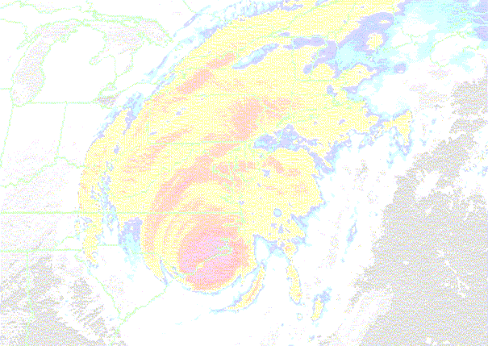
2021 Official Hurricane Name List
Ana
Bill
Claudette
Danny
Elsa
Fred
Grace
Henri
Ida
Julian
Kate
Larry
Mindy
Nicholas
Odette
Peter
Rose
Sam
Teresa
Victor
Wanda

Slide 79
HURRICANE SEASON 2021
According to NOAA, there is a 70% probability for the following ranges of hurricane activity for 2021
7-12 named storms (winds 39 mph or higher)
3-6 hurricanes (winds 74 mph or higher)
2-3 hurricanes making landfall on US East Coast
0-2 major hurricanes (winds of at least 111 mph)
The start of hurricane season is a reminder that our families, businesses and communities need to be ready for the next big storm. Preparedness today can make a big difference down the line, so update your family emergency plan and make sure your emergency kit is stocked. Learn more about how you can prepare for hurricane season at www.ready.gov/hurricanes.
Are You Prepared?

Slide 80
Emergencies and disasters can strike anytime!
Does your business have a contingency plan???
Goals of contingency planning:
Ensure continued performance of essential functions
Minimize damage
Reduce/mitigate disruptions to operations
Protect essential assets
Achieve timely recovery
For more information on how to develop a contingency plan for your business contact Pasquotank-Camden Emergency Management Agency at 252-335-4444.

Slide 81

DON’T GET CAUGHT UNPREPARED!
Take responsibility for your own safety by being prepared with plans and an emergency supply kit for any emergency.
Emergency Supply Kit Essentials:
Water – 1 gallon per person per day (a 3-7 day supply is recommended)
First aid kit
Pre-cooked, non-perishable food (i.e. canned goods granola bars, cereal)
Flashlight and extra batteries
Essential medications
Portable radio and extra batteries
Cash and change
Food, water, leash, and carrier for pets
Anti-bacterial hand wipes or gel

Slide 82
Develop a Family Disaster Plan
Discuss the types of hazards that could affect your family. Know your home's vulnerability to high winds and flooding.
Locate the safest areas in your home for each hurricane hazard.
Determine escape routes from your home and safe places to meet.
Have an out-of-state friend as a family contact, so all your family members have a single point of contact.
Make a plan now for what to do with your pets if you need to evacuate.
For additional information:
www.fema.gov/areyouready
www.ReadyNC.org
www.Ready.gov
Or contact your local Emergency Management Office at 252-335-4444

Slide 83
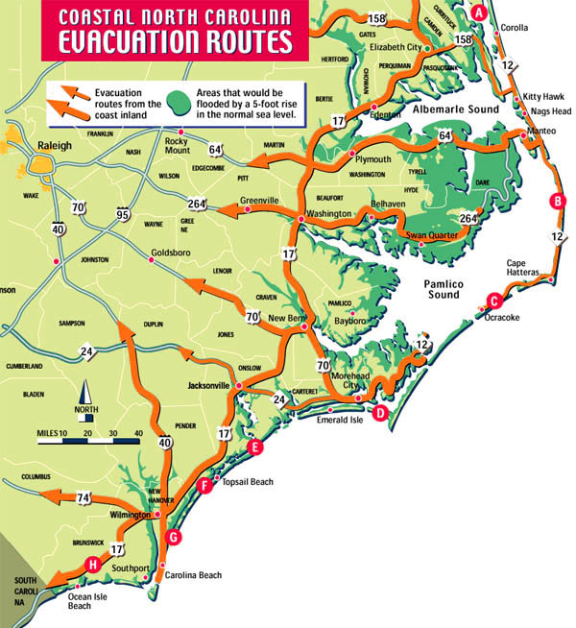
EMERGENCY NOTIFICATION
When severe weather is approaching the area listen to LOCAL radio stations, county/city cable access channels, and TV channels for information
.
If authorities decide to evacuate an area for your protection, it is important to stay calm, listen carefully, and follow instructions.
If you live in a mobile, modular, manufactured home or structurally unstable dwelling in an evacuation zone or low-lying area, YOU SHOULD EVACUATE!
The first inland shelter in Northeastern North Carolina is in Pasquotank County at the K.E. White Center on Weeksville Road. There are no shelters in Dare, Currituck, or Camden Counties. The K.E. White Center has a shelter capacity of 450.

Slide 84
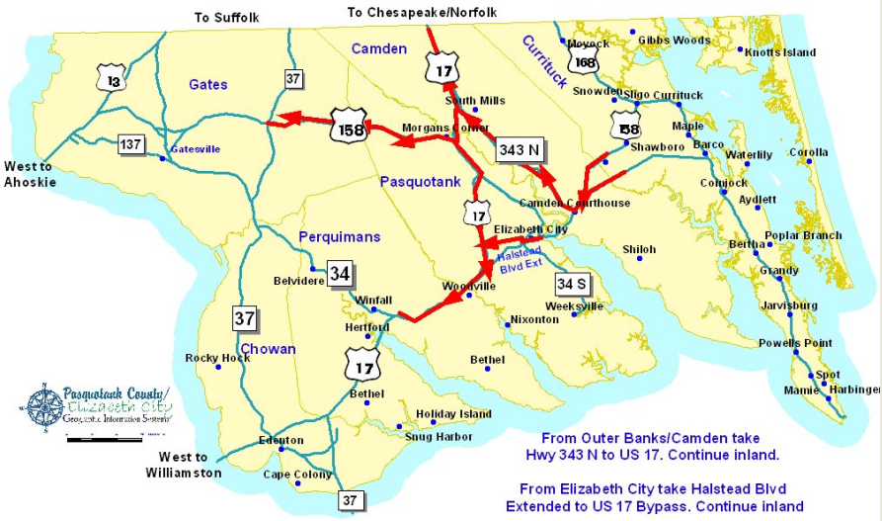
Routes to Take if Evacuation is Ordered

Slide 85

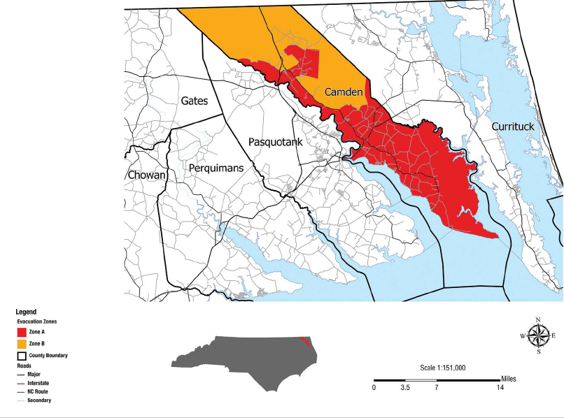

The Know Your Zone lookup tool is a new color-coded interactive map you can use to determine the evacuation zone where you live, work, or are visiting based upon your street address.
Evacuation zones highlight areas most at risk to storm surge and flooding. Local officials will determine which areas should be evacuated. Areas in Zone A will typically be evacuated first, followed by areas in Zone B.
For additional information – visit the Pasquotank-Camden-Elizabeth City Emergency Management website @ pasquotankcountync.org/pcecem or call 252-335-4444.

Slide 86
Notice
Camden County
Tax Listing Dates
All persons who own property subject to taxation must list such property within the period set forth and any persons who fail to do so will be subject to penalties prescribed by law.
Due to legislation, real property and licensed vehicles, unless registered with permanent tags, do not require listing by the taxpayer. If you listed for the 2021 tax year you should receive a listing form by mail, all other personal property, boats, unlicensed vehicles, farm equipment, etc. can be listed with a lister located in the County Assessor’s Office between the hours of 8am and 5pm Monday thru Friday starting January 1st thru January 31st 2022.
Slide 1 of 2

Slide 87
Notice
Camden County
Tax Listing Dates: Tax-Reduced Valuation
Persons who are 65 years of age or older, totally and permanently disabled, or are a disabled veteran may qualify for tax reduced valuation.
Persons owning property under cultivation, in forest management or in horticulture may also qualify for tax-reduced valuation. For qualifications contact the Assessor’s office at 252-338-1919.
Slide 2 of 2

